Slide 1
WELETRICITY
Developed by Ninja Hertz
Nicola, Nicolas, Josh

Slide 2
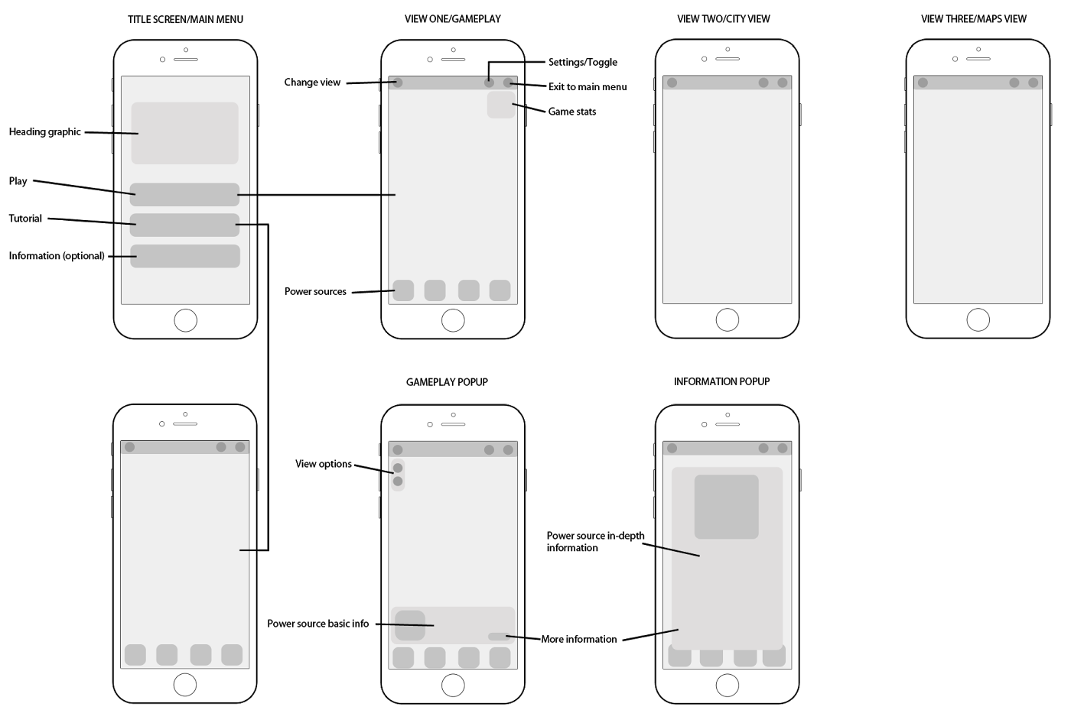
MOBILE CLIENT

Slide 3
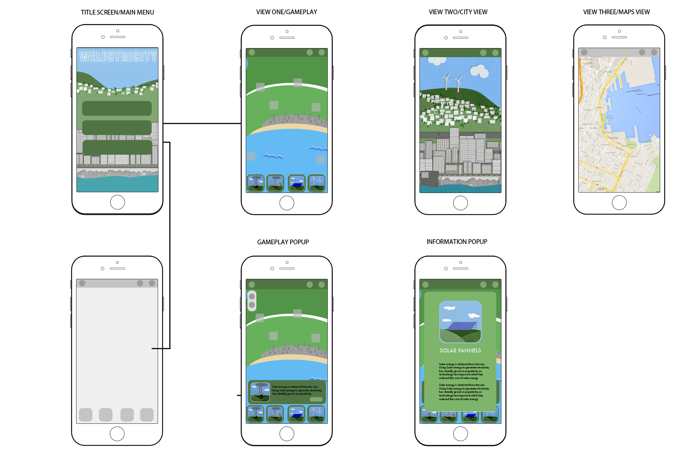
MOBILE CLIENT

Slide 4
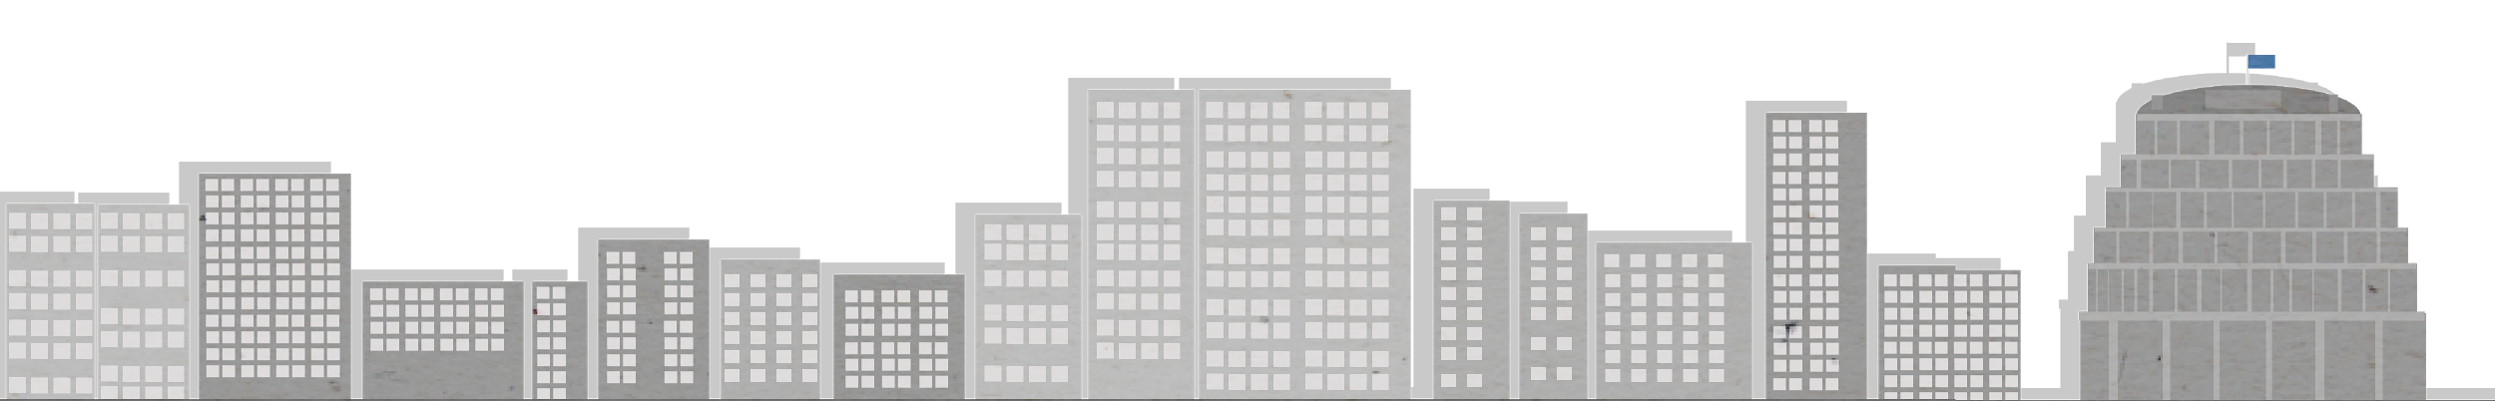
USERS AND ART DIRECTION
5-12 Yr old children
Pop up story book style
Consistent colour palette

Slide 5
APPLICATION ARCHITECTURE
Client
display game screen
user register/login
get score from server
save/load game data to/from server
Server (Heroku)
login user check
response data
save/load data
Authentication
OAuth

Slide 6

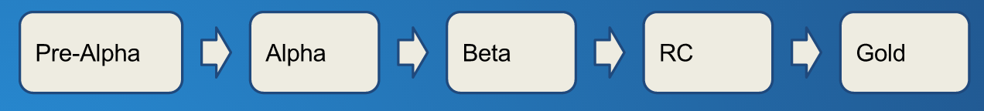
TESTING
We’re going to use kids to test our app
(After rigorously testing ourselves)

Slide 7

OUR PLAN
DEMONSTRATION VIDEO:
Filmed, with narration added overtop
BRIEF APPLICATION AD:
Professional
Shots of kids playing Weletricity

Slide 8
LEFT TO DO
Update graphics
Game system
Mini animations
Pop Up info boxes
Calculations on Wellington power
Tutorial
Login/Password screen
Mini details (people/cars etc)
Sound (song + some sound effects)
Google maps page
Tie in user registration to front end
Tie in save game
Tie in Power Plant loading and info
Tie in pause

Slide 9
WHO’S DOING WHAT
Tony:
Server/back end
Power Plant info & loading
Page architecture: city view,
credits, information
John:
Game engine
Server: save/load/pause/user registration
Drag and drop game play
Server architecture
Google maps page

Slide 10
WHO’S DOING WHAT
Josh:
Title screen
Splash screen
Animations
Pop up boxes
Typography
Research and calculations
Sound
Nicola:
City view graphics
Parallax
Sound
Research and calculations
Navigation
Colour scheme
Overall art director
Nicolas:
Gameplay Screen
Gameplay Screen art
Gameplay icons
Log in screen
Log in screen icons
Gameplay

